Slide 1
Reflections on Developing and Evaluating Virtual Reality Fieldtrips (VRF): the student’s perspective
Jennifer Stewart, Catherine Gorman, Louise Bellew
School of Hospitality Management and Tourism
TU Dublin, Ireland
catherine.gorman@tudublin.ie

Slide 2
Developing and Evaluating Virtual Reality Fieldtrips (VRF): the student’s perspective
What did we do:
‘to gather student perspective in using technology to develop and evaluate virtual reality fieldtrips’
Why did we do it:
Unable to run the fieldtrip to the Burren, Co. Clare due to Covid 19 restrictions
Contribute to existing work on fieldtrips/site visits exploring the use of technology
Using an adapted UTAUT model (Venkatesh 2003) evaluate the students focusing on use, adoption and perceptions of using technology as part of delivery.
Explore the future use of technology and its input into a co-created Year 4 optional module on Fieldtrips
Who were involved:
66 Level 8 students
DT406T/3 (BA in Tourism Management)
DT8412/2 (B.Sc. in Tourism and Digital Marketing)
DT518/2 (B.Sc. In International Languages and Tourism)
Industry Input
Mary Bermingham, Creative Director and Owner, Burren Nature Sanctuary, www.burrennaturesanctuary.ie; Gary Pearson Fourth Reality www.fourthreality.com; Paul Delaney CellNex www.cellnextelecom.ie and Jarleth O Dwyer, CEO of BEN (Burren Ecotourism Network) www.burren.ie

Slide 3
How was it done?
An integrated assessment was developed between the modules:
TFTR2005 Sustainable Tourism (5 credits)
TFIT3008 Technology and Tourism (5 credits)
Using Google Earth, Screen-o-matic and other similar apps, students developed walking trails around two chosen sites in the Burren, County Clare, and Phibsboro, Dublin 7.
The message conveyed in the short videos had to focus on sustainable tourism( raising awareness) and demonstrate an understanding
A group written submission using theory to evaluate the methods used, challenges, and provide evident understanding of sustainable tourism (video content)
Sustainable Tourism and Technology’ Seminar organised as part of Green Week, TU Dublin 2021
Co-creation of criteria with industry ( Mary Bermingham)
Peer and industry evaluation of the videos including written feedback

Slide 4
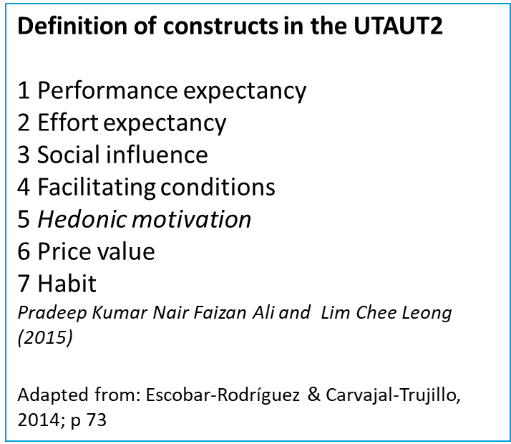
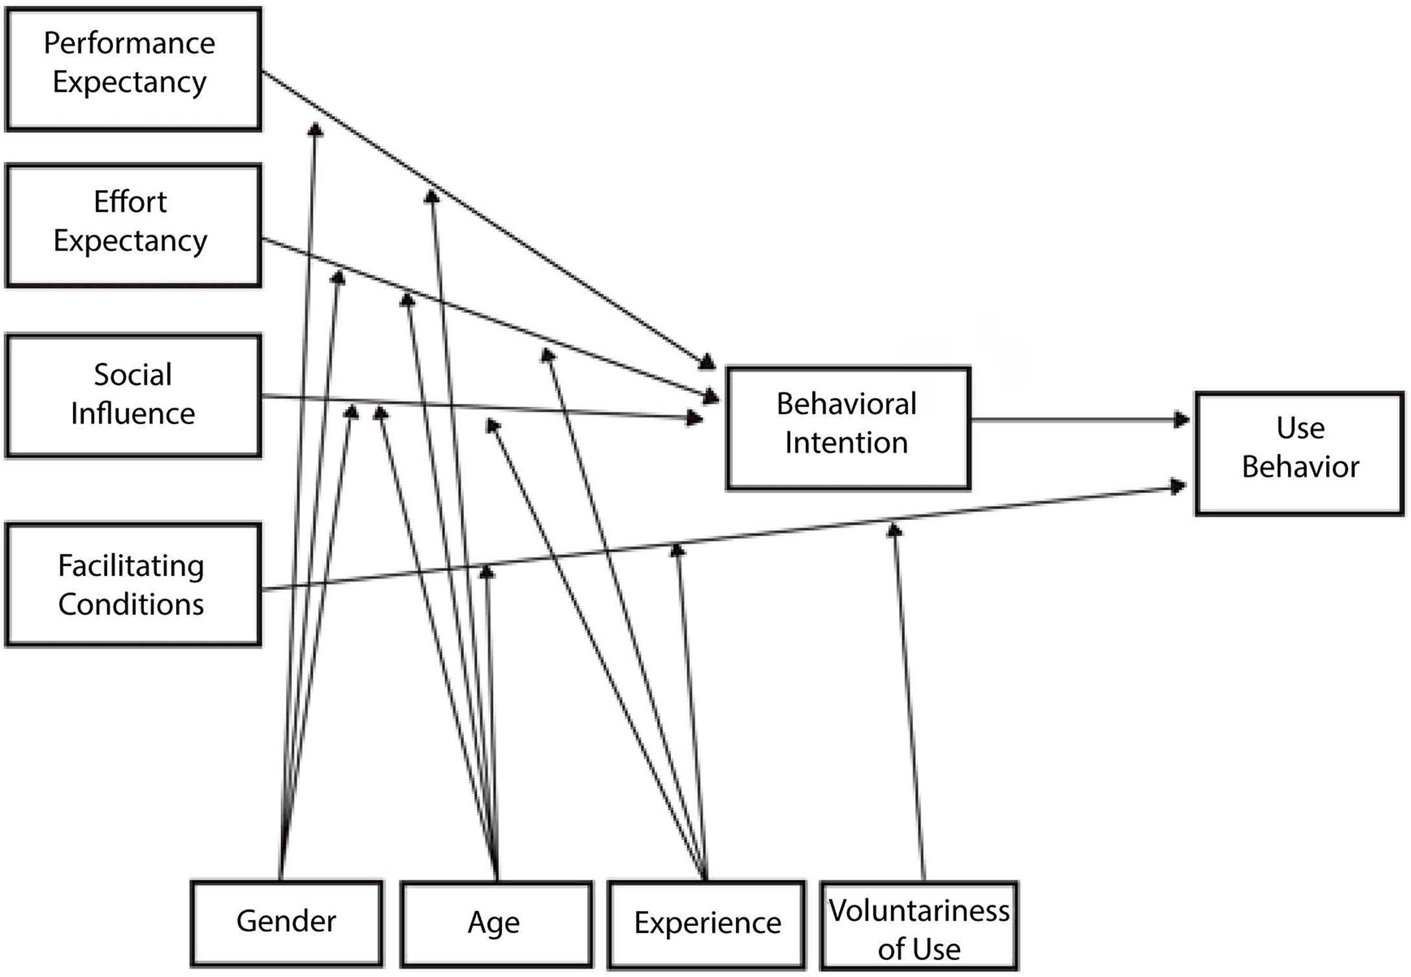
Theoretical Underpinning
The benefits of experiential education using site visits and fieldtrips : Educational (Ruhanen2005; Van Dorean and Corrigan 2008), Social (Marvell, Simm, Schaaf and Harper 2013; Brent Gregory 2011)
Conceptual Model towards a new paradigm for tourism education (Kongtaveesawas and Prasarnpanich 2020), integrating technology as industry demands
The use of the UTAUT Model (Ventekesh 2003) followed by the adapted use of constructs of UTAUT2 , validated (Pradeep Kumar, Nair Faizan Ali and Lim Chee Leong (2015).
Similar study undertaken Rausher et al. (2020)

Slide 5
Development of a Measurement Tool
Student Survey
Series of 20 statements based on adapted constructs:
Performance expectancy
Effort expectancy
Social influence
Facilitating conditions
Using VR/technology for Educational purposes
Using VR/tech for sites visits/fieldtrips
Familiarity and use
Five point Likert Scale
Administered post module delivery on-line
28 responses to questionnaire
2 . Student feedback through QA (Q6A)

Slide 6
1. Student Survey Responses
Adapted Construct | Question theme | Positive | Negative | Neutral
Performance expectancy | Technology enhanced | 78.9 | 0 | 21.4
 | A Better Job | 50 | 14 | 36
 | Helped | 75 | 3.6 | 21.4
Effort expectancy | Took longer than expected | 53.5 | 21.4 | 25.1
 | Worth it | 71.4 | 7.2 | 21.4
 | Try my best | 92.9 | 0 | 7.1
Social influence | Expectation from industry | 89.2 | 3.6 | 7.1
 | Friends enjoy using | 67.9 | 10.7 | 21.4
 | Need to embrace | 67.9 | 14.3 | 17.9
Facilitating conditions | Ease of use | 57 | 10.7 | 32.3
 | Support received | 39.3 | 10.7 | 50
 | Prefer self- directed | 32.1 | 25 | 42.9
Using VR/technology for Educational purposes | Learnt a great deal | 57.1 | 7.2 | 35.7
 | Focused more on tech than content | 25 | 42.9 | 32.1
 | As a positive inclusion in educational delivery | 60.7 | 17.9 | 21.4
Using VR/tech for sites visits/fieldtrips | Can play a role | 57.1 | 21.4 | 21.4
 | Better way of learning | 39.3 | 25 | 35.7
 | Act as a substitute | 46.7 | 42.9 | 10.7
 | Familiarity with/at ease with | 82.2 | 7.1 | 10.7
 | Would rarely use | 64.2 | 17.9 | 17.9
Table 1: Responses (%) n=28

Slide 7
Taking some key results
Adapted Construct | Question theme | Positive | Negative | Neutral
Performance expectancy | Technology enhanced | 78.9 | 0 | 21.4
 | A Better Job | 50 | 14 | 36
 | Helped | 75 | 3.6 | 21.4
Effort expectancy | Took longer than expected | 53.5 | 21.4 | 25.1
 | Worth it | 71.4 | 7.2 | 21.4
 | Try my best | 92.9 | 0 | 7.1
Social influence | Expectation from industry | 89.2 | 3.6 | 7.1
 | Friends enjoy using | 67.9 | 10.7 | 21.4
 | Need to embrace | 67.9 | 14.3 | 17.9
Facilitating conditions | Ease of use | 57 | 10.7 | 32.3
 | Support received | 39.3 | 10.7 | 50
 | Prefer self- directed | 32.1 | 25 | 42.9
Using VR/technology for Educational purposes | Learnt a great deal | 57.1 | 7.2 | 35.7
 | Focused more on tech than content | 25 | 42.9 | 32.1
 | As a positive inclusion in educational delivery | 60.7 | 17.9 | 21.4
Using VR/tech for sites visits/fieldtrips | Can play a role | 57.1 | 21.4 | 21.4
 | Better way of learning | 39.3 | 25 | 35.7
 | Act as a substitute | 46.7 | 42.9 | 10.7
 | Familiarity with/at ease with | 82.2 | 7.1 | 10.7
 | Would rarely use | 64.2 | 17.9 | 17.9
Table 3: Some results of interest

Slide 8
Some Cross Tabs
Question theme | Positive | Negative | Neutral
Technology enhanced (1) x can play a role (16) | 57.2 | 21.4 | 21.4
Helped (3) x a positive inclusion (15) | 60.7 | 17.8 | 21.4
Familiarity with/at ease with (19) x can play a role (16) | 82.2 | 7.1 | 10.7
Can play a role (16) x Better way of learning (17) | 57.2 | 21.4 | 21.4
Better way of learning (17)x Act as a substitute(18) | 39.3 | 35.7 | 25
Table 4: Some cross-tabs (%)

Slide 9
2. Reflections and Findings
Anon – though still power at play
1. Reflections on Survey Responses
Doubt that students would not say that they tried their best (or may be the better students in the class engaged with the survey)
Further support required in terms of using the technology?
A quarter focused on tech over content
Less than half would see it as a better way of learning though
57% learnt a great deal from making the video
Over 40% did not think it would be a substitute for site visits/fieldtrips
A reasonably high number would rarely use tech if they had the choice (17.9%)
2. QA Responses
Positive feedback in terms of delivery on both modules
No reference to the assignment in the Sustainable Tourism module
Some said that technology was not something they were used to using as part of an assignment
Some enjoyed making videos and that they were beneficial and relevant to the industry
Although students commented that they are at ease using the technology , some found difficult to use screen-cast-o-matic

Slide 10
Limitations
Conducted entirely through on-line and virtual means
Conducted anonymously
Not mandatory to respond
Mainly female respondents (F:23, M:5) as per Rauscher et el. (2020)
Class total N=66 ( only 42% response rate)
Three survey ( 2 QA – one for each module, survey linked to the project)
End of year fatigue ( tech)
What next:
Initial scoping exercise: in-depth qualitative research required
Use of reflective techniques interspersed through module delivery
Use of technology as an integrated approach to planning, delivering and evaluating site visits and fieldtrips
Next stage (2021/22)
Continue with the integrated approach to assessment
Develop the use of technology within both modules to facilitate learning and engagement with the industry and
ultimately making sense of place!

Slide 11
References
Chia-Pin Yu, A.B., Hsiao-Yun Lee, C. Wen-Hsin Lu,A. , Yu-Chih Huang,D. Matthew H.E.M., Browning, E. (2020) Restorative effects of virtual natural settings on middle-aged and elderly adults. Urban Forestry and Urban Greening (56) pp. 1-10.
Gibson, A., & O’Rawe, M. (2018). Virtual reality as a travel promotional tool: Insights from a consumer travel fair. In T. Jung & M. C. Tom Dieck (Eds.), Augmented Reality and Virtual Reality (pp. 93–107). Springer
Kongtaveesawas, N. and Prasarnpanich, P. (2020) The new paradigm for undergraduate tourism. Paper presented at ISPIM Connects Bangkok – Partnering for an Innovative Community, Bangkok, Thailand on 1-4 March 2020.
Pradeep Kumar Nair Faizan Ali and Lim Chee Leong (2015),"Factors affecting acceptance & use of ReWIND: validating the extended unified theory of acceptance and use of technology", Interactive Technology and Smart Education, Vol. 12 Iss 3 pp.
Rauscher, M., Humpe, A. and Brehm, Lars, (2020) Virtual Reality in Tourism: Is it ‘Real’ Enough? Academica Turistica , Year 13, No. 2 Dec. pp. 127-138.
Gwo-Jen Hwang, Shao-Chen Chang, Pei-Ying Chen, Xiang-Ya Chen (2018) Effects of integrating an active learning-promoting mechanism into location-based real-world learning environments on students’ learning performances and behaviors Education Tech Research Dev 66 pp.451–474.
Michael D. Williams, Nripendra P. Rana and Yogesh K. Dwivedi School of Management, Swansea University, Swansea, The unified theory of acceptance and use of technology (UTAUT): a literature review UK Journal of Enterprise Information Management Vol. 28 No. 3, 2015
Many thanks to the National Teaching and Learning Forum, funders of IMPACT www.teachingandlearning.ie

