Slide 1
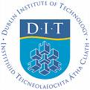
Perspective on Church Tourism in Ireland
Dr. Kevin Griffin
Head of Tourism Department
Dublin Institute of Technology

Slide 2
Context
Academia
  ATLAS Religious Tourism Special Interest Group
Personal Research Interests
  Irish Traveller Community
Genealogy
  Some reflections on Ireland

Slide 3
Academia

Slide 4
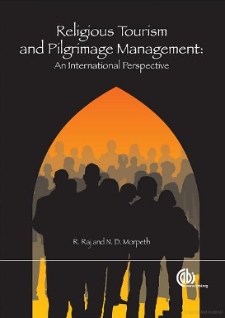
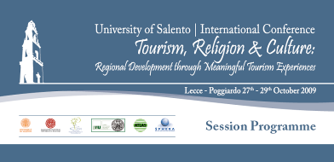
ATLAS Religious Tourism Special Interest Group

Slide 5
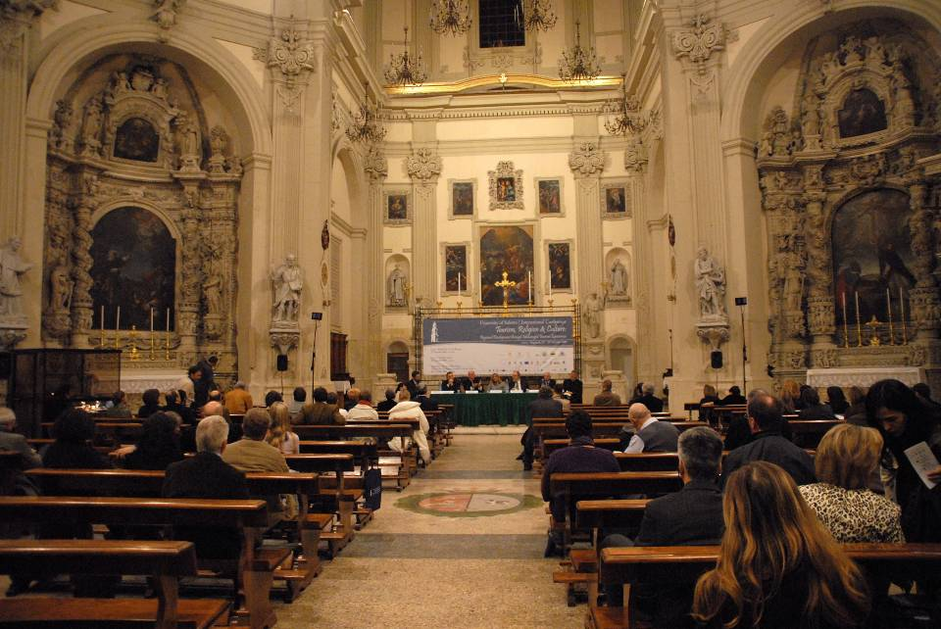

Slide 6
Issue 1: Focus of Pilgrimage Research
Glocalisation?
Contradiction in a
Globalising World

Slide 7
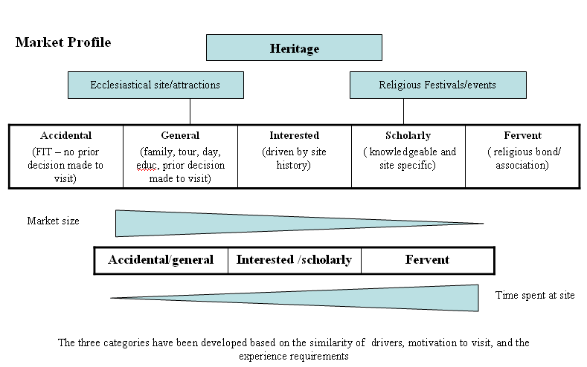
Classifying Visitors

Slide 8
Issue 3: Audience / Research Pop.
Core / Normal / Standard
In Ireland we focus on :
  Roman Catholic
  Regular Mass attendees
  Settled / comfortable / middle-old age etc.
  ‘Native Irish’

Slide 9
My Personal Research
The Irish Travelling Community

Slide 10
Insights into faith
‘Travellers are very religious. I love a lot of blessed pictures and statues and plenty of holy water in the place. If I miss Mass it takes a lot out of me. Travellers believe a lot in priests and cures. We are very superstitious - marriages and black cats. We believe in ghosts - it gives us an idea that there's life after death. . . ’ We wouldn't miss the patterns of the graves. --Kathleen McDonagh
(Traveller Voices, Pavee Point Travellers Centre )

Slide 11
Insights into faith
(from interviews and focus groups)
When I was young we travelled and slept in tents on the side of the road – I was born in the County Home in . . . and baptised in . . . My mother made sure we were settled in a stable campsite for our communion and confirmation – but she had no care for reading or writing – you could get on without them.
. . . He wasn’t a great goer of mass, but he always said his prayers every night.

Slide 12
Insights into faith
(from interviews and focus groups)
I can’t do the rosary right, but I’m trying to learn (grandmother)
‘You have your own belief’
‘Our Lady is always here’
I believe in Our Lady and the Sacred Heart and all the Angels and Saints
I’ve been to Meduguorgie three times this year already (young male c.20yrs)
The Lady has been good to us (male c.40yrs)

Slide 13
Knock
No. 1 visited site in Ireland
c.1million visitors (pilgrims?) per year
Marian Shrine
Formally recognised by the Catholic Church
Visited by Pope John Paul II (1979)

Slide 14
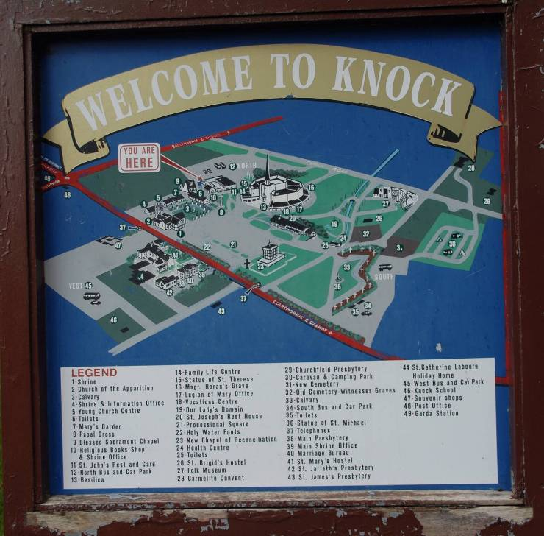
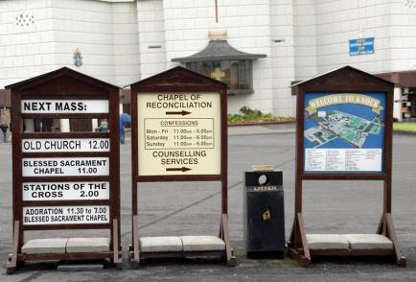
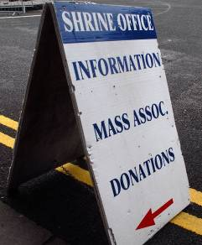

Slide 15
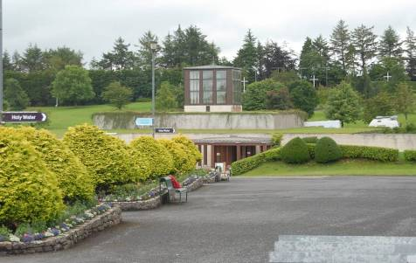
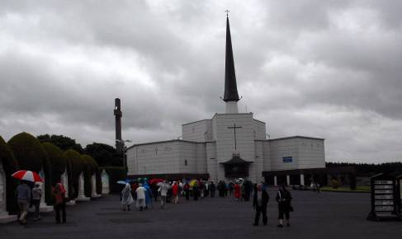
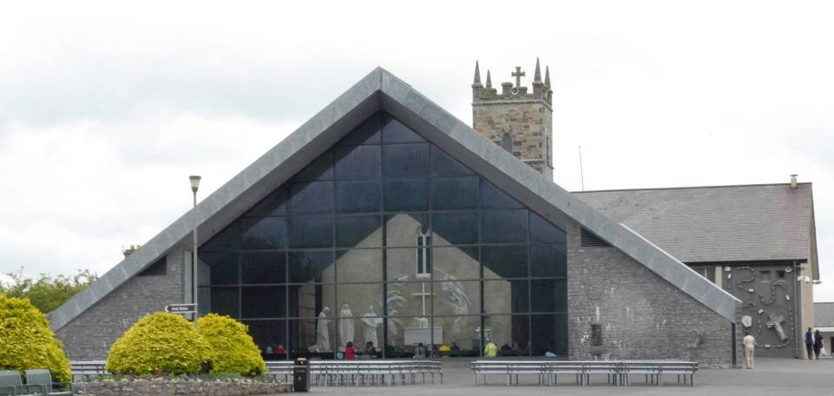

Slide 16
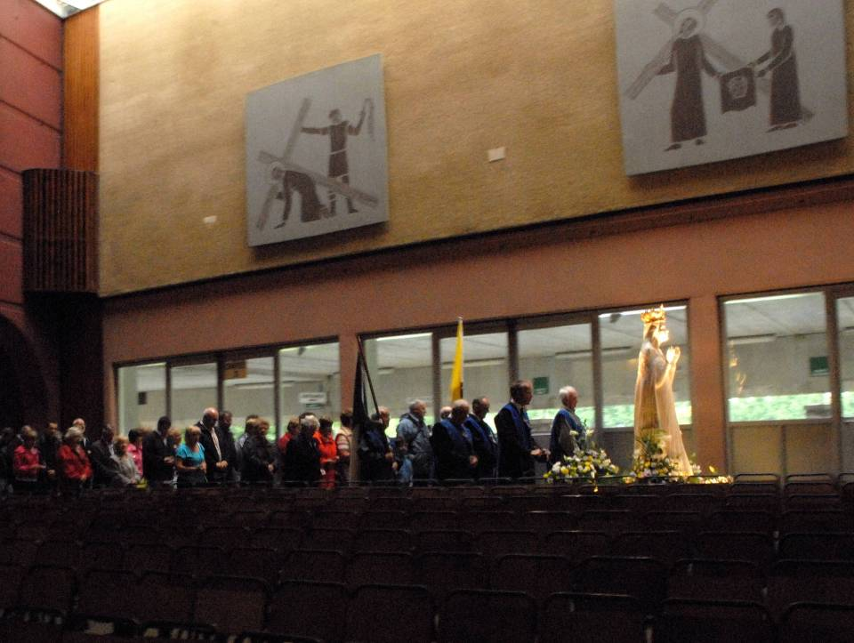
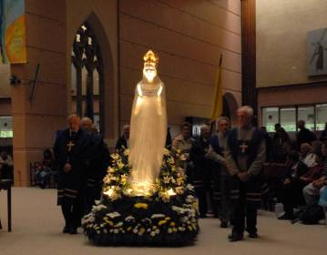

Slide 17
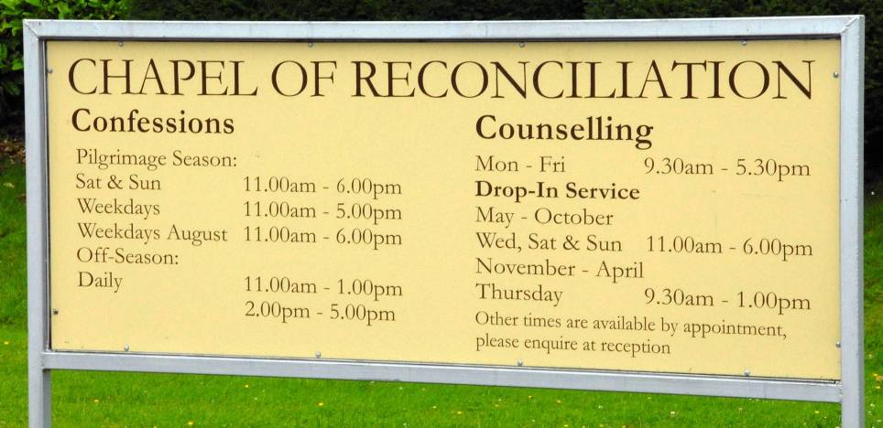
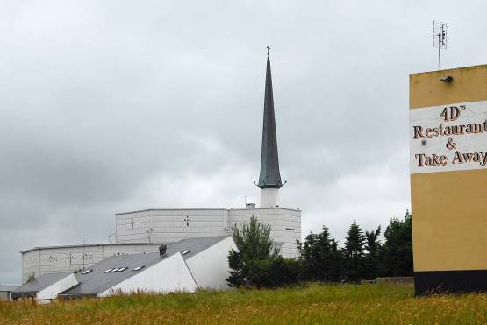
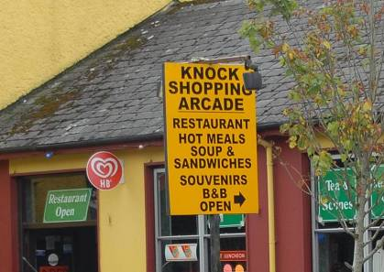

Slide 18
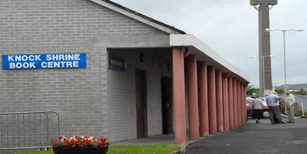
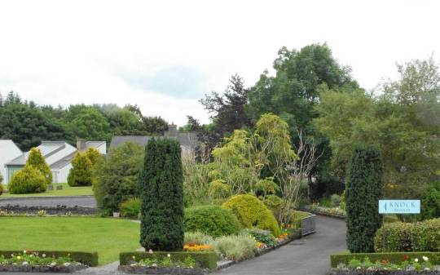
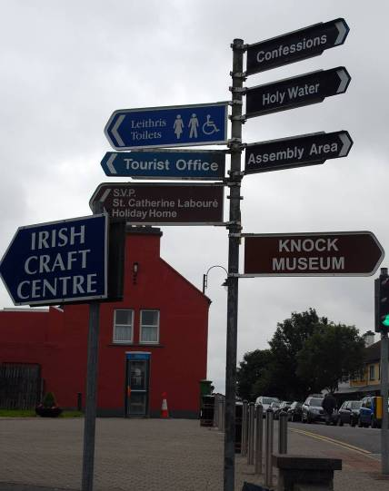
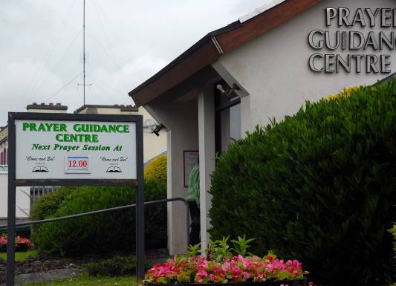
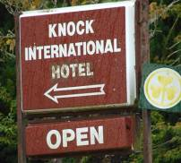

Slide 19
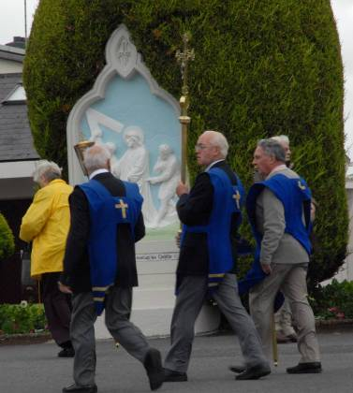
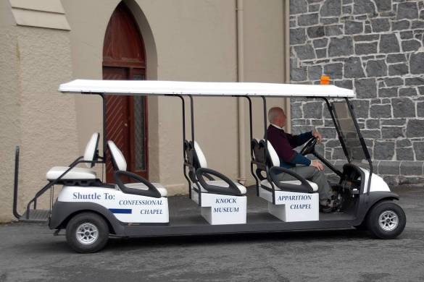
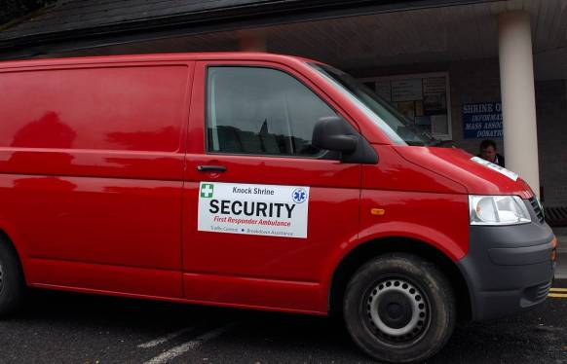
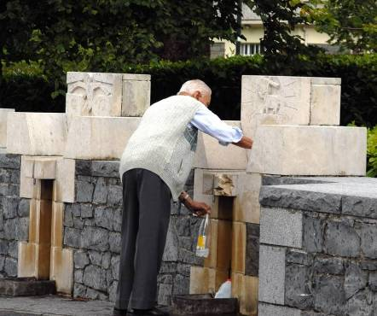

Slide 20
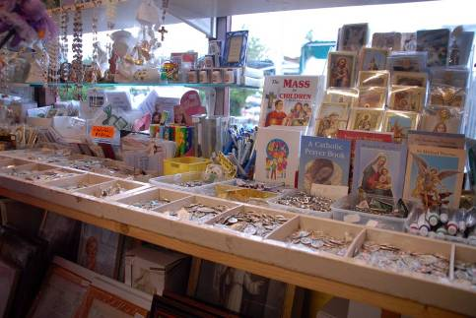
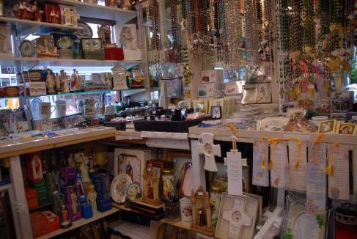
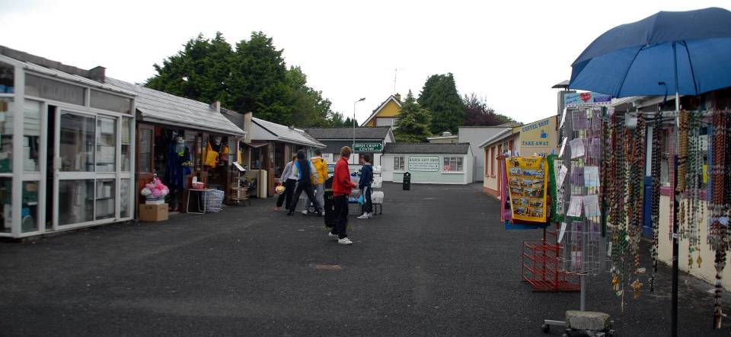
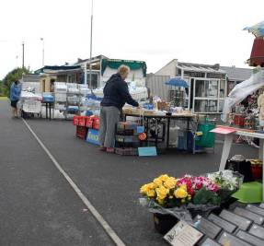

Slide 21
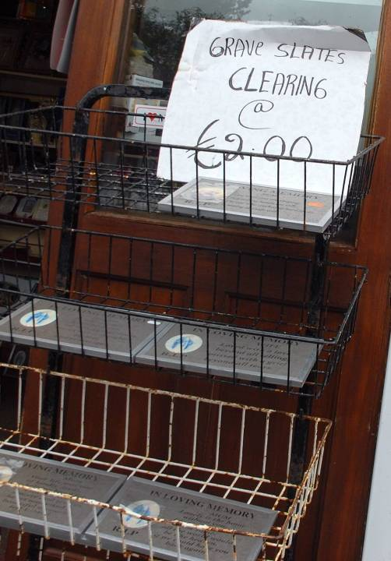
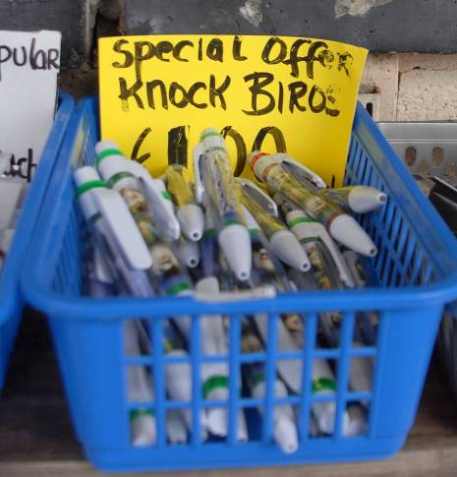
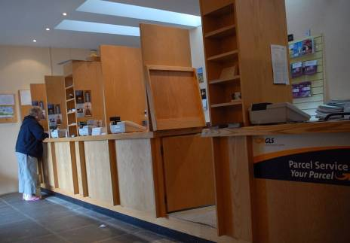

Slide 22
Many questions for Knock
As an academic I can pick holes in this site because it is -
  trendy
  great fun
  gratifying to my intellectual ego.
BUTTTTTTT:
Many sceptics question the ‘validity’ of experience at such a site.
Does this site cater for ‘all’ visitors / pilgrims
Is this level of ‘organisation’ needed at sites
How much of the illustrated fabric fits into the ‘sacred’ end of the continuum and how much into the ‘secular’ end ?

Slide 23
Traveller’s Comments on Knock
‘In Knock you really feel closer to Our Lady – where she appeared’
‘The statue procession is wonderful’
‘This is a peaceful and holy place’
‘There are no words to describe my experience of Knock’
‘Everybody should come here’

Slide 24
Other (domestic) sites visited by Travellers

Slide 25
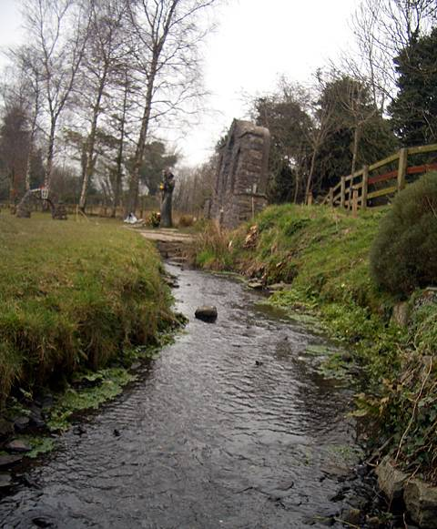
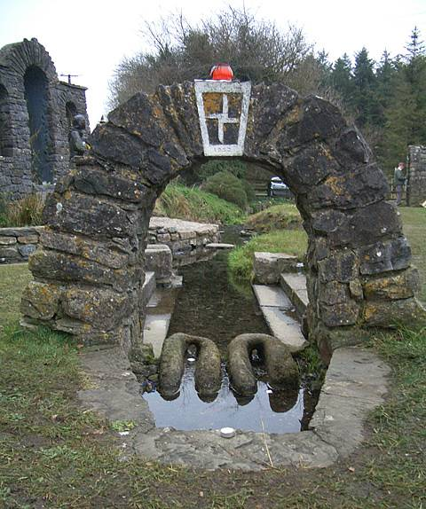
St Brigid’s Well Kildare

Slide 26
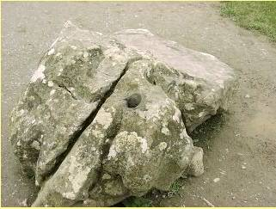
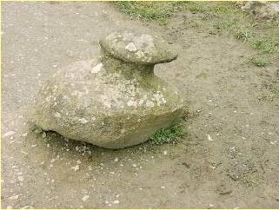
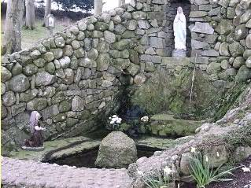
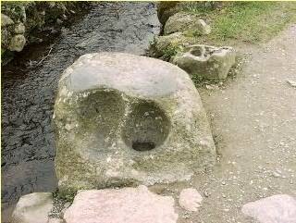
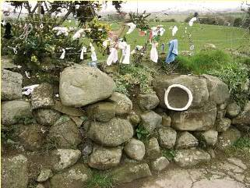
St Brigid’s Stream & Well - Faughart, two miles north-west of Dundalk
Eye Stone
Hip / Leg Stone
Knee Stone
‘We Visit for Intentions and cures’
Head Stone

Slide 27
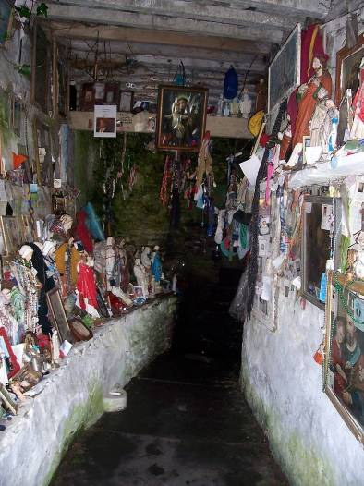
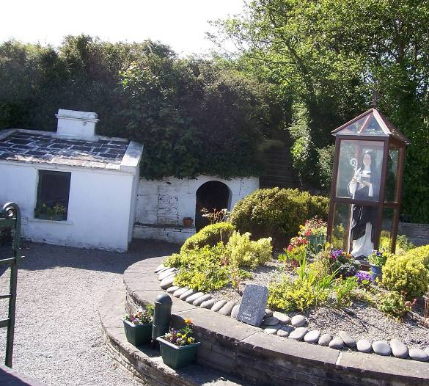
St Bridget’s Well Liscannor, Co. Clare

Slide 28
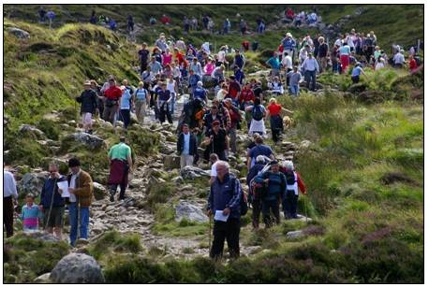
Croagh Patrick (The Reek)

Slide 29
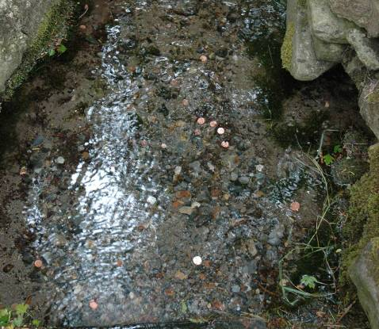
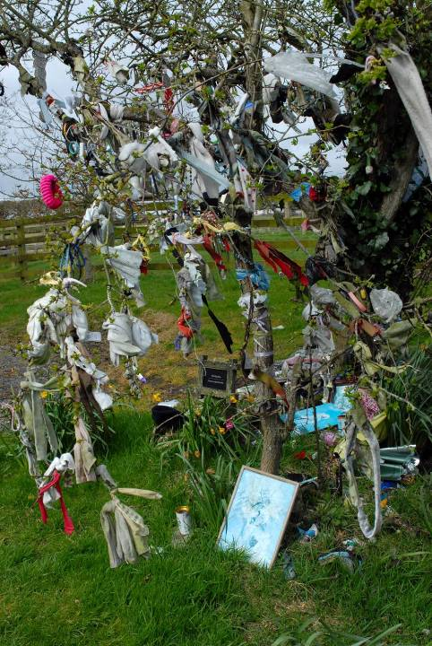
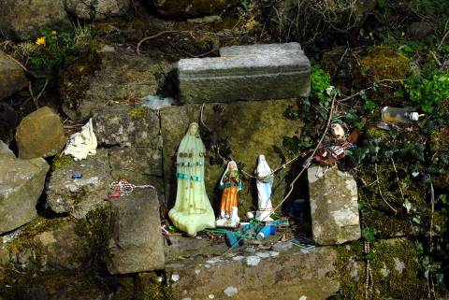
Killeigh (The Seven Blessed Wells

Slide 30
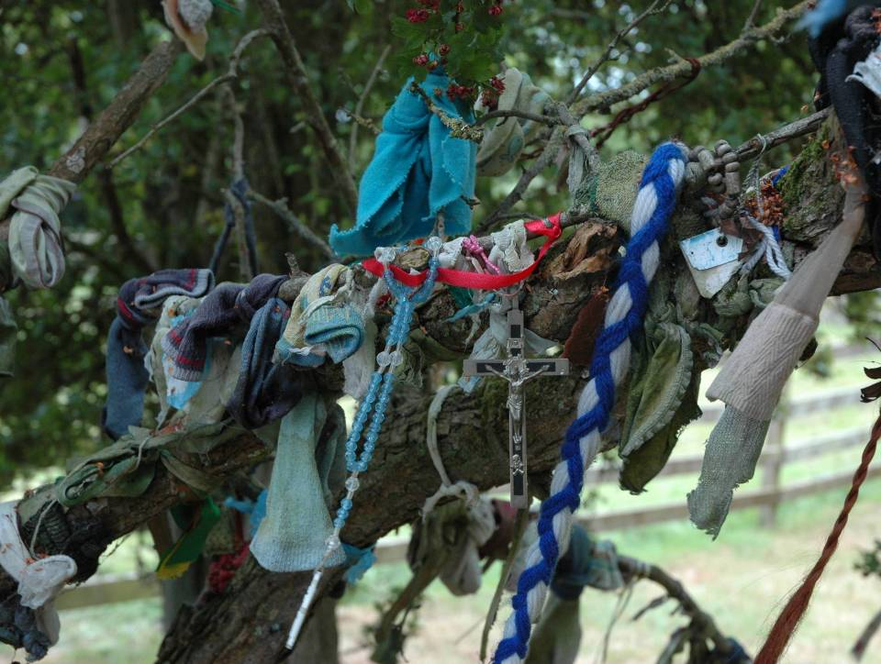
‘we leave something from sick people’

Slide 31
Genealogy in Ireland

Slide 32
Genealogical Tourism
Recorded Genealogy Tourism peaked in the year 2000 - 116,000 ‘Genealogical Visitors’ came to the island (Bord Failte, 2001).
However, have ceased recording Genealogy Visitors numbers from 2004.
Recent years focus on investment in ‘special interest’ and ‘niche markets’
: ‘a number of issues of management . . . impact on the . . . capacity of . . . stakeholders to maximise genealogy tourism’ (Department of Arts, Sports and Tourism, 2005 pp 91).

Slide 33
Australian and New Zealand in 2008 - Electronic Direct Marketing (EDM) campaigns and the ‘Go Green – Discover your Irish side’ campaign (Tourism Ireland c, 2008).
Now tourism marketing focus on areas
  ‘where Ireland may have a particular competitive advantage. Possible segments include.....The wider Irish Diaspora (including Scots-Irish) (Tourism Renewal Group, 2009 pp 44)

Slide 34
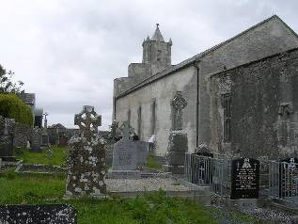
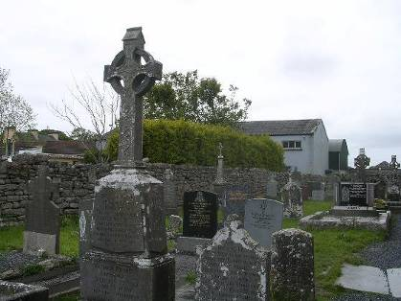
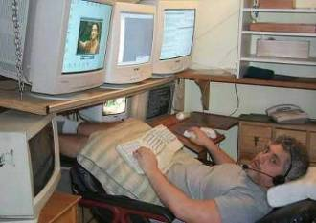
Who is the Genealogical tourist / visitor?

