Slide 1
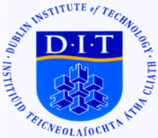
Contemporary Shifts in Pilgrimage Practices and the Effects on Traditional Management Practices at Sacred Sites: An Irish Perspective
Vreny Enongene, Doctoral Researcher & Dr Kevin Griffin
Dublin Institute of Technology,
School of Hospitality Management and Tourism,
Cathal Brugha Street. Dublin 1
Pilgrimage and the Evolution of Spiritual Tourism WIT, Waterford. Ireland
9th of March 2018

Slide 2
Growth of Religious Tourism and Pilgrimage
World religious travel fastest growing segments in travel
Significant & rapidly growing segment. An estimated (300-330mn) visitors to sacred sites annually & 60% Tourists,
Economic Benefit Estimated at $18bn USD (Tourism & More, 2014)
Numbers expected to DOUBLE in 2020, and 40% from Europe,
(UNWTO, 2014, Tourism & More, 2014)
Appeal to people of all ages and all nationalities

Slide 3
In the Irish Context
Despite the global recession there was 5% increased in Religious Tourism to Ireland
(Tour Operator Globus, 2011)
Steep Increase in Religious / Spiritual Tourists in Ireland
(Enongene, 2016)
(Enongene & Griffin, 2017)
Some Changes in Traditional Practice of Pilgrimage are seen among Modern-day Pilgrims
(Kartal et al, 2015; Enongene & Griffin, 2017)

Slide 4
Changing Nature of Contemporary Christian Pilgrims
Typical Faith-based Tourist
Changing Needs
Changing Expectation of Site
Changing Purchasing behaviour
Infrastructural Changes
Growing Need for Entertaining Experiences and Satisfaction from the spiritual renewal services
Consumption of High- End Products
The Author’s 2018

Slide 5
Changes in Traditional Pilgrimage Patterns
Traditional Forms of Pilgrimage
Questions the Role pilgrimage plays in the life of Contemporary Christians
More Sophisticated Ritualistic Approach
No money no purse, no sandals
Little food
Non conformity to changing World patterns
Renewed services
Need for a contemporary touch to ecclesiastical infrastructures, toilets, restaurants , high end accommodation units En-suit accommodation
The Author’s 2018

Slide 6
Why Research in the Area?
Scholars have highlighted the importance of management awareness for the needs of modern-day pilgrims
(Collins-Krener & ….2010)
Has not Received Considerable attention in the Religious & Pilgrimage Tourism Scholarship
(Enongene& Griffin, 2018)
ISSUE
Emerging Challenges for sacred site Custodians meeting these changing contemporary pilgrims requirements
(Enongene, & Griffin, 2017)
The Effects / Impacts of Pilgrims changing behaviour and requirement to Traditional Management Approaches at Sacred Sites and their implications
(The Authors, 2018)
Implications for Future Pilgrimage Practices
Upholding Traditional Values
(The Authors, 2017)
The Author’s 2018

Slide 7
No scholarly Exploration of the phenomenon globally and in the Irish context in particular
Research Question
How does meeting the changing needs and expectations of contemporary pilgrims impact on traditional management Practices and Values at Irish Sacred Sites?

Slide 8
Research Methodology & Data Analytical Approach
Mixed Data analytical Approach -Thematic and Discourse Analytical Approaches were employed in analysing the Data
Semi-structured
In-depth interviews
Key Custodians
Across Diverse Category of Irish Sites In 4 provinces in island of Ireland
Manually Transcribed
Thematic Analysis
Discourse Analysis
Data Analysis

Slide 9
Research Findings
Participant Discourses reveals that meeting these changing needs have had significant effects on traditional management practices at these sites.
There has been a significant shift in traditional management focus
Transformative Managerial Approaches
Increased pressure from meeting these needs have compelled custodians to be very transformative in their management approaches
“ As participants recounts;
“It is completely changing the dynamics of how we do things and how we engage with them. So it is transformative”…..because we are really getting into the heart of all of that…..
Detracting from Original Spiritual Focus
“Maintaining the sacredness of the site and catering to these changing requirements I suppose overwhelms us at times errr….to the extent that you might focus on simply the work and organisation and maintenance of the place as distinct from its spiritual values, so we have to keep a very fine balance

Slide 10
Research Findings (Cont.)
Adaptability to Changing Cultural Values
“ we can’t just continue to live like this, we have to develop, diversify, upgrade and you know we need to kind of enhance, what we are doing because we can’t keep doing the same things over and over we need to adapt to the culture as well again to a certain degree
Challenges are a good thing after all
“ the challenges have been positive, I mean really positive, we have been able to witness increase visitor numbers, after we responded to pilgrims demands for improved facilities based on our survey findings. We have also realised that ever since the refurbishment of the…….. there has been increased visitor numbers and an extended pilgrimage season….this had never been the case in many years-especially we have had many visitors surprisingly during the winter months this is usually a very quite time for us.

Slide 11
Conclusions / Research Implications / Further Research
Meeting these changing requirements of contemporary pilgrims and sacred site visitors, are altering traditional management practices and are seen to somewhat detract custodians from their original mission
The study has significant implications for the effective management of contemporary sacred site visitors changing demands, where there is a need to understand the future of pilgrimages and the authenticity, integrity and sustainability, of these sacred places.
The research opens avenue for more investigations into the effects or impacts of meeting these changing pilgrims / visitors requirements and the implications for upholding traditional spiritual values.

Slide 12
Food for thought
Have pilgrimages really undergone a fundamental change in recent times?

Slide 13
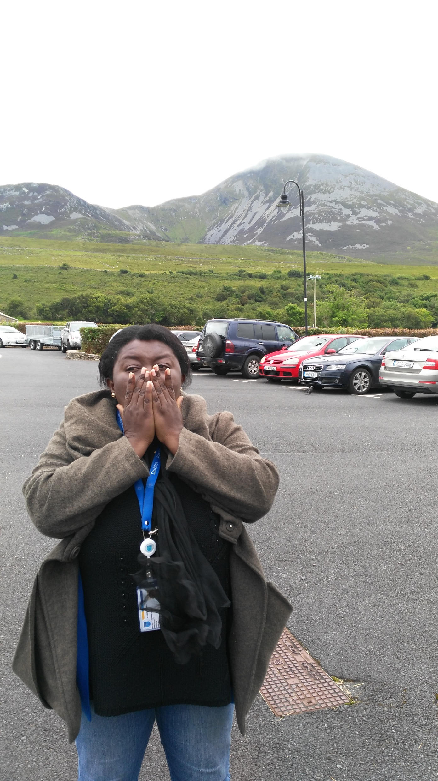
Thank You

