Slide 1
Critical Media Literacies:
Collaboration and Partnership
Róisín Guilfoyle
Sarah-Anne Kennedy
Seirbhísí Leabharlanna ITBÁC DIT Library Services

Slide 2
Information
wants to be free*
Notes:
I wanted to give you some context. Everything we do is set in a specific context, that context can be changed and things can be taken out of context, but broadly speaking messages come with a context. You’ve already selected the context within which you’ll hear about CML by coming to this conference. And you’ve further narrowed that context choosing to hear the speakers in this room….
So let’s look at the broader context of our library and information environment

Slide 3
But…
Information
Also wants to be expensive
-Stewart Mader
Notes:
This famous quote by Steward Mader, was never meant to be a rallying call to people who had no respect for copyright. Its more a recognition of the importance and value of information. As well the difficulty of controlling information you created when it becomes digital…

Slide 4
+
+
Technology
Connectivity
Information
Democratisation of Information?
Notes:
Developments in technology has lead to cheaper hardware, the development of the internet has lead to a more connected world, and information is more accessible.
Potentially we now appear to have a perfect partnership of cheap, easy use hardware and masses of free information on any subject you can think of.
But are we better informed citizens?
Are we digital natives, or digital immigrants? Are we born with magical abilities that help us to navigate a digital world?
Based on his observations, Prensky thought so. That was in 2001 but since then research has been carried out and shown that there really is no such thing as a digital native/immigrant – skills are learned or acquired in the usual way, regardless of when you were born.
If our past experience of assuming and assigning skills to our digital natives has taught us anything, it has taught us that it isn’t safe to assume a skill set, are we in danger of making the same assumption about our users being information literate? Recent research has shown that consumers – that is information consumers, feel the closer to the top a sites placement in the search results, the more reliable it is – they don’t pay attention to who put that information there or why they put it there.
But the technology has been hacked by trolls and marketers, people pushing an agenda
I’m sure I don’t need to remind everyone about the proliferation of fake news and conspiracy theories that abounded during the recent American presidential elections. Companies like Facebook, have been told to improve their ability to weed out fake news and hoax. How’s that working…

Slide 5
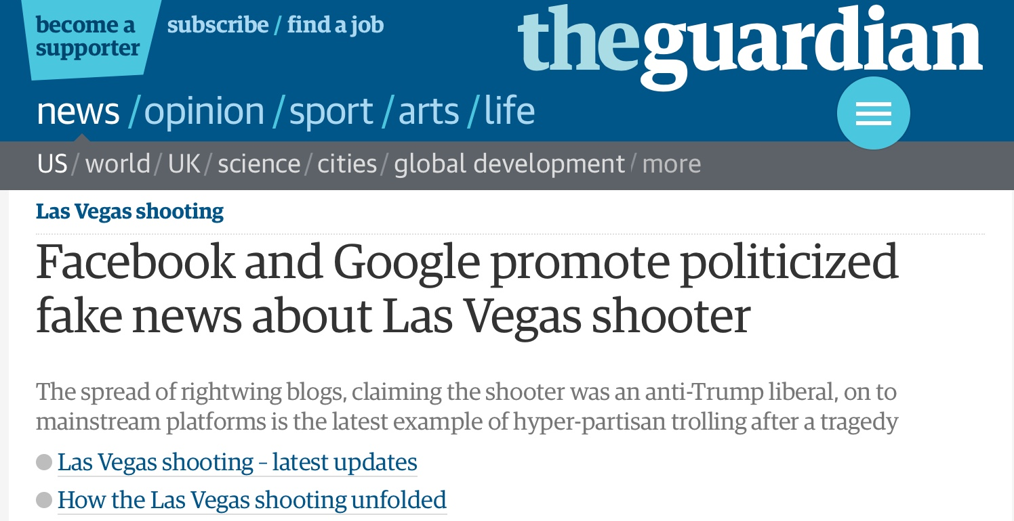
Notes:
This headline is from the Guardian newspaper. It’s a story relating to a rumour that the perpetrator of the Las Vegas shooting was an anti-Trump democrat…
Of course it’s not true, both Google and Facebook admit this. Lies and fake news spread from social media to tradition media at an alarming rate.
So what are libraries doing about this?

Slide 6
Libraries…
Democratising information for
millennia
Notes:
Librarians have be trying to democratising information for some time. Making information available by collecting and organising it in one place. Granted in the beginning we had limited success in that you had to be reasonably well off and usually male to benefit, but we had the right idea and it caught on.

Slide 7
+
X
Technology
Connectivity
Information
More Information
Seirbhísí Leabharlanna ITBÁC DIT Library Services
Notes:
Developments in technology has lead to cheaper hardware, the development of the internet has lead to a more connected world, and information is more accessible.
Potentially we now appear to have a perfect partnership of cheap, easy use hardware and masses of free information on any subject you can think of.
But are we better informed citizens?
Are we digital natives, or digital immigrants? Are we born with magical abilities that help us to navigate a digital world?
Based on his observations, Prensky thought so. That was in 2001 but since then research has been carried out and shown that there really is no such thing as a digital native/immigrant – skills are learned or acquired in the usual way, regardless of when you were born.
If our past experience of assuming and assigning skills to our digital natives has taught us anything, it has taught us that it isn’t safe to assume a skill set, are we in danger of making the same assumption about our users being information literate? Recent research has shown that consumers – that is information consumers, feel the closer to the top a sites placement in the search results, the more reliable it is – they don’t pay attention to who put that information there or why they put it there.
But the technology has been hacked by trolls and marketers, people pushing an agenda
I’m sure I don’t need to remind everyone about the proliferation of fake news and conspiracy theories that abounded during the recent American presidential elections. Companies like Facebook, have been told to improve their ability to weed out fake news and hoax. How’s that working…

Slide 8
“All Librarians do is stamp and shelve books and tell people to be quiet”
Stereotype Alert
Seirbhísí Leabharlanna ITBÁC DIT Library Services
Notes:
Talk about stereotype of the role of Librarian.

Slide 9
Supporting Learning, Teaching and Research
with Space, Staff & Service
Collection Development -print & online
Reader Services
Archives
Digital Archives -Arrow
Research Support
Teaching
(to name a few..)
Seirbhísí Leabharlanna ITBÁC DIT Library Services
Notes:
Introduce different roles-traditional and new. Physical and virtual space. We teach!

Slide 10
What do we teach?
Information Literacy
Students -all levels, all disciplines from undergraduate to research
One-2-one support -formal and informal
Classes
Embedded modules -involved in assessment
Developing RLOs
Staff
Seirbhísí Leabharlanna ITBÁC DIT Library Services
Notes:
Introduce the teaching we do

Slide 11
“Information literacy is a set of abilities requiring individuals to recognize when information is needed and have the ability to locate, evaluate, and use effectively the needed information."
-American Library Association (ALA)
Seirbhísí Leabharlanna ITBÁC DIT Library Services
Notes:
Definition of IL

Slide 12
“Knowing when and why you need information, where to find it, and how to evaluate, use and communicate
it in an ethical manner."
-Chartered Institute of Library Information Professionals (CILIP)
“Information literate people will demonstrate an awareness of how they gather, use, manage, synthesise and create information and data in an ethical manner and will have the information skills to do so effectively.”
-The Society of College, National and University Libraries (SCONUL)
Seirbhísí Leabharlanna ITBÁC DIT Library Services
Notes:
More definitions of IL

Slide 13
[Media Literacy is]… the ability to access, analyze, evaluate and create media in a variety of forms...It provides a framework to access, analyze, evaluate and create messages in a variety of forms - from print to video to the Internet.
-Center for Media Literacy (CML)
Seirbhísí Leabharlanna ITBÁC DIT Library Services
Notes:
Definition of media literacy

Slide 14
"[Critical Media Literacy is]...an educational response that expands the notion of literacy to include different forms of mass communication, popular culture, and new technologies. It deepens the potential of literacy education to critically analyze relationships between media and audiences, information, and power. Along with this mainstream analysis, alternative media production empowers students to create their own messages that can challenge media texts and narratives."
-(Kellner & Share, 2007, p.60)
Seirbhísí Leabharlanna ITBÁC DIT Library Services
Notes:
Definition of Critical Media Literacy

Slide 15
Find
Access
Use/Create
Evaluate
Educate
Empower
Critical Analysis
Ethics
Seirbhísí Leabharlanna ITBÁC DIT Library Services
Notes:
Common themes between all 3 definitions.

Slide 16
The SCONUL Seven Pillars of Information Literacy
Information Literacy Competency Standards for Journalism Students and Professionals
________________________________________
The Society of College, National and University Libraries (SCONUL)
Association of College & Research Libraries (ACRL)
________________________________________
Identify
Scope
Plan
Gather
Evaluate
Manage
Present
Plan
Find
Evaluate for Accuracy & Fairness
Draft & Create
Ethical & Legal Standards
Seirbhísí Leabharlanna ITBÁC DIT Library Services
Notes:
More common themes between the literacies

Slide 17
What is cause for separation?
“Our findings from 1956 to 2012 show that the two fields have different authors, university affiliations, and journals; they also differ in terms of academic origin, scope, and social concern. Information literacy has a closer tie to library science, while media literacy is more related to media content, media industry, and social effects. Due to their different academic orientations, the two fields adopt different analytical approaches.”
-(Lee & So, 2014, p.137)
Seirbhísí Leabharlanna ITBÁC DIT Library Services

Slide 18
Let’s focus on what’s similar:
“Although media literacy and information literacy look like two separate fields, both concepts share the common goal of cultivating people’s ability to access, understand, use, and create media messages or information. In the literacy family, they have always been seen as being closely linked.”
-(Lee & So, 2014, p.138)
We have the same end goal
Seirbhísí Leabharlanna ITBÁC DIT Library Services

Slide 19
We need to collaborate:
“The BAI has chosen to publish this document in the spirit of collaboration and in the hope that the framework will help all stakeholders and recognise what role they can play and identify opportunities for collaboration”
-Broadcasting Authority of Ireland (BAI)
Media Literacy Policy
Seirbhísí Leabharlanna ITBÁC DIT Library Services

Slide 20
This matches our experience:
“Which websites are the good ones and which are the bad ones?”
“Which journal articles are the best ones? I want the top ten.”
Why did you quote this in your assignment?
Because it matches my topic
What do you use for your assignments?
Google
Do you read newspapers?
No
Where do you get your news?
*Shrug of the shoulders
“That’s too long. It seems good but I don’t want to read all of it. Have you got anything shorter?”
Seirbhísí Leabharlanna ITBÁC DIT Library Services
Notes:
Quotes from students

Slide 21
‘Information Literacy’, ‘Critical Media Literacy’ and ‘Media & Information Literacy’ don’t resonate with students. How do we reach them?
Seirbhísí Leabharlanna ITBÁC DIT Library Services

Slide 22
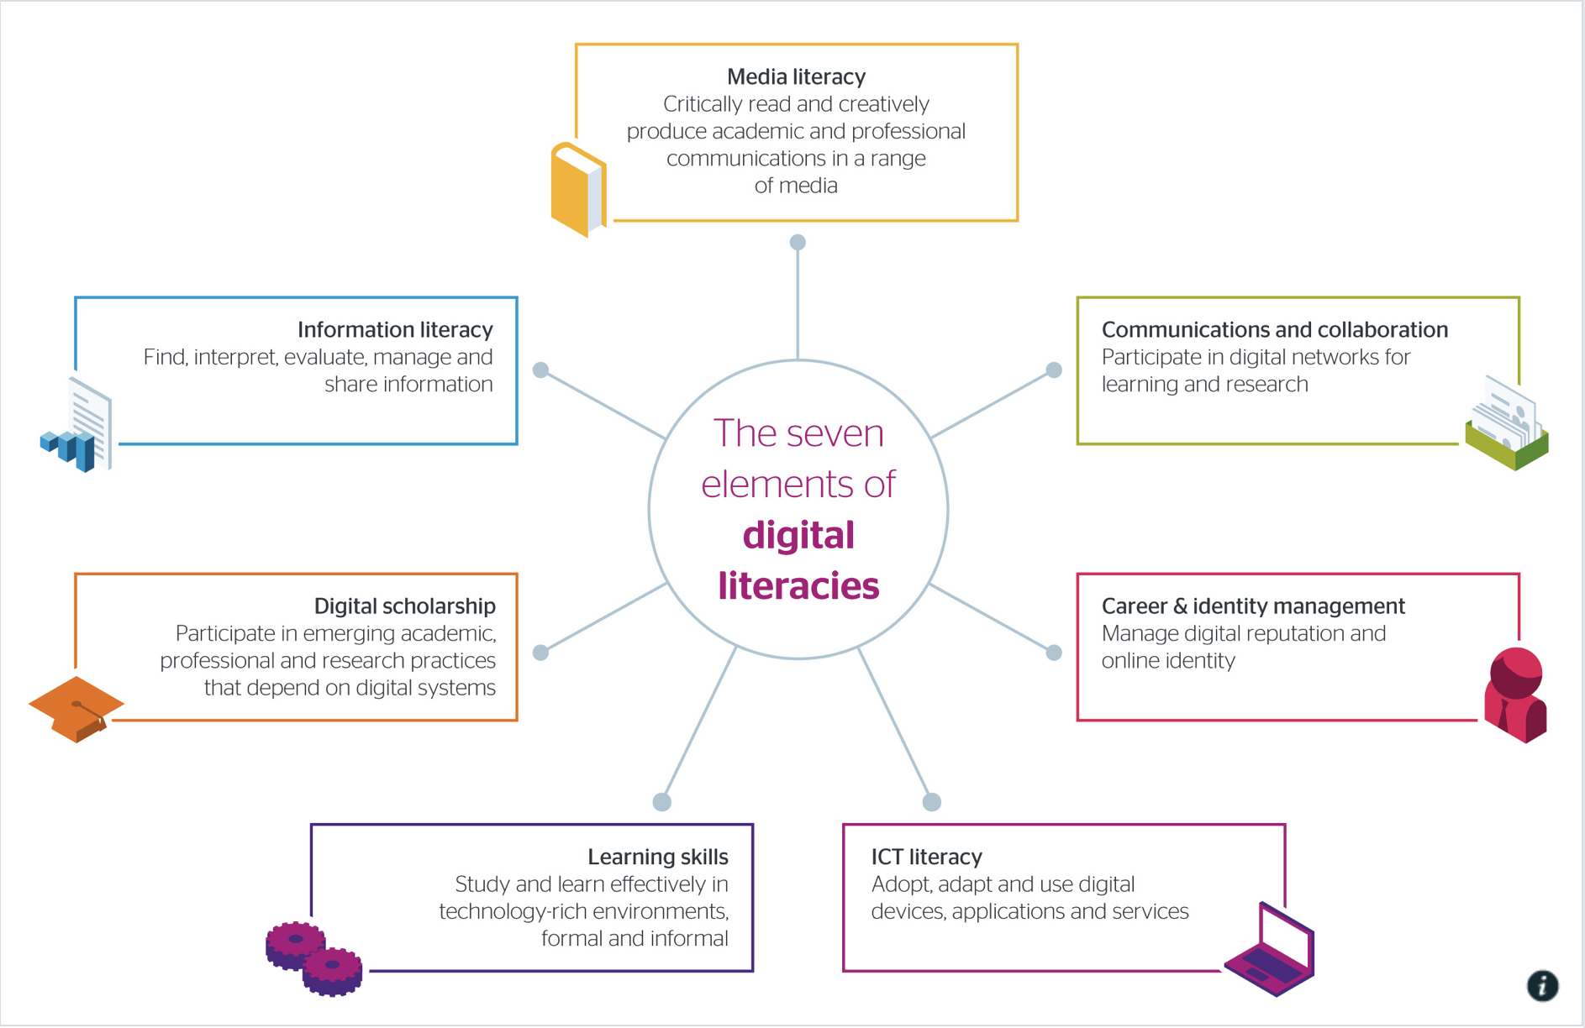
Seven Elements of Digital Literacy
-JISC
Seirbhísí Leabharlanna ITBÁC DIT Library Services
Notes:
JISC seven elements of digital literacy. Media Literacy usually seen as a subset of Information Literacy. With this model not one element or literacy takes precedence over another.

Slide 23
What are young people familiar with?
Media Literacy not previously a core subject in school. Up to individual teachers to teach.
Digital Media Literacy is now a subject on Junior Cycle.
Digital Literacy is a DIT graduate attribute
The term ‘Digital Literacy’ will mean something to future students.
Seirbhísí Leabharlanna ITBÁC DIT Library Services

Slide 24
How can we collaborate?
Develop embedded Digital Literacy modules that include essential elements of IL and CML
Blended learning -face-2-face and RLOs
Become partners on the Digital Campus of DIT and the TU4D.
Seirbhísí Leabharlanna ITBÁC DIT Library Services

Slide 25
Critical Media Literacy
Information Literacy
+
Democratisation of Information
Seirbhísí Leabharlanna ITBÁC DIT Library Services
Notes:
We think it is important to recognise that within CML there is a need for information skills, and perhaps that is the perfect partnership.

Slide 26
Thank you
Roísín Guilfoyle
Sarah-Anne Kennedy
DIT Library Services

